Slide 1
Face Mask Detection Using Machine Learning
Project Associates:
M. Jahnavi(20NN1A1286)
N. Poojitha(20NN1A1280)
B. Hemalatha(20NN1A1272)
G. Revathi(20NN1A1282)
Project Guide:
Lakshmi Durga

Slide 2
Contents:
Abstract.
Introduction.
Existing model.
Proposed system.
Requirement specification.
Drawbacks of existing model.
Designing
Coding and execution.
Conclusion.

Slide 3
Abstract
Covid-19 also known as Serious Acute Respiratory Syndrome corona virus-2 is an infectious disease that is released from an infected sick person who speaks, sneezes, or coughs by respiratory droplets. This spreads quickly through close contact with anyone infected, or by touching objects or surfaces affected with a virus. There's still currently no vaccine available to protect against COVID-19 and preventing exposure to the virus seems to be the only method to safeguard ourselves.
Wearing a facemask that covers the nose and mouth in a public setting and often washing hands or the use of at least 70% alcohol-based sanitizers is one way to avoid being exposed to the virus.
Amid the advancement of technology, Deep Learning has proven its effectiveness in recognition and classification through image processing. The research study uses deep learning techniques in distinguishing facial recognition and recognize if the person is wearing a facemask or not.

Slide 4
Introduction
Identification of problem domain :
Raise of COVID cases.
Best solution is to wear a face mask.
Majority citizens are not following.
Results in rigorous spread of virus.

Slide 5
Existing Model
CNN - used in prediction problems
Existing model - face detection
Model – struggles in detecting the faces with mask
Bad in low light conditions

Slide 6
Proposed System
Our proposed study uses the architectural features of VGG-16 as the foundation network for face recognition and the Fully-Convolutional segmentation network. The VGG-16 network is fairly robust in extracting features and less costly in computational terms. Nevertheless, most segmentation architectures consecutively rely on input image downsampling and upsampling.In proposed system we are detecting the people with the mask and no mask.
To detect the presence of mask on human face.
Detects the face accurately even in the low light.
Identifies whether the mask is placed properly or not.

Slide 7
Requirement Specification
The project involved analyzing the design of few applications so as to make the application more users friendly. To do so, it was really important to keep the navigations from one screen to the other well ordered and at the same time reducing the amount of typing the user needs to do. In order to make the application more accessible, the browser version had to be chosen so that it is compatible with most of the Browsers.
Operating Systems Supported : windows 7 , windows 8 , windows 10 , windows XP.
Technologies and languages used to Develop : Python , JupyterNotebook , Pycharm.
Software Requirements : Python
Hardware Requirements : Pentium 4 or higher processor , RAM : 256 Mb , HardDisk : min 512 Mb
Functional Requirements : Graphical user interface with user

Slide 8
Drawbacks of Existing Model
Takes more time to classify the mask images because of its long complex structure.
It is not deployed completely.

Slide 9
Designing
Design is a multi step process that focuses on data structure, Software architecture, procedural details and interface between modules.
The purpose of the design phase is to plan a solution of the problem specified by the requirements document.
The design of a system is perhaps the most critical factor affecting the quality of the software.
It has a major impact on the project during later phases, particularly during testing and maintenance.

Slide 10
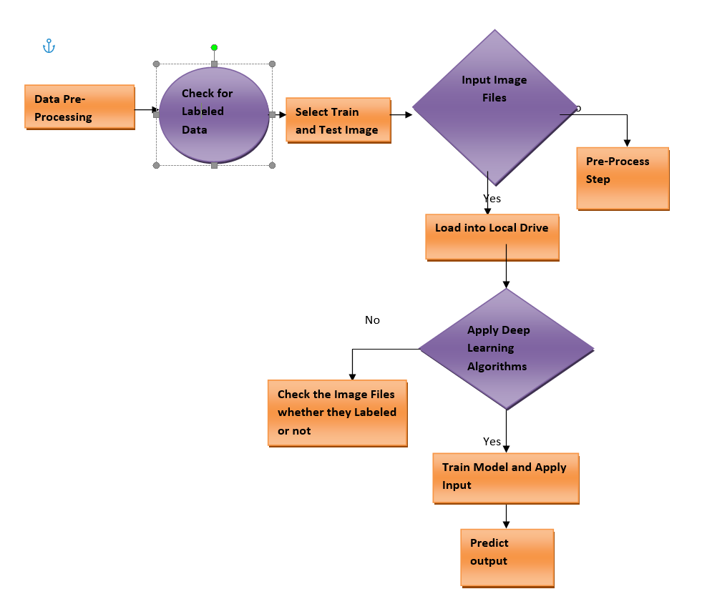
System Architecture

Slide 11
Activity Diagram

Slide 12
Sequence Diagram

Slide 13
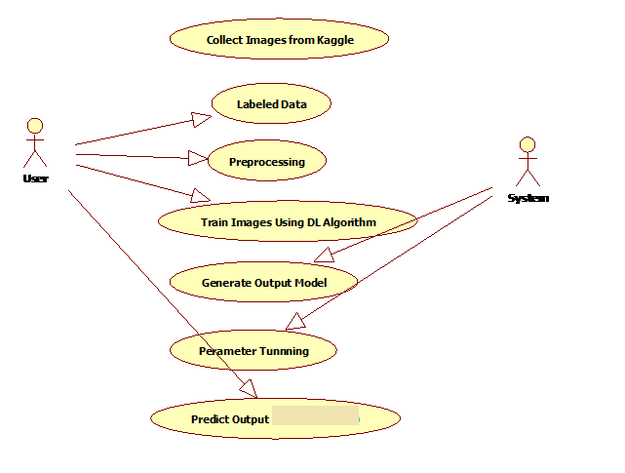
Use Case Diagram

Slide 14
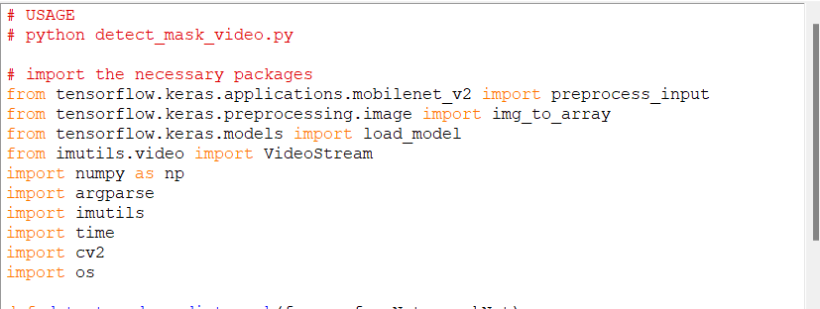
Coding and Execution

Slide 15
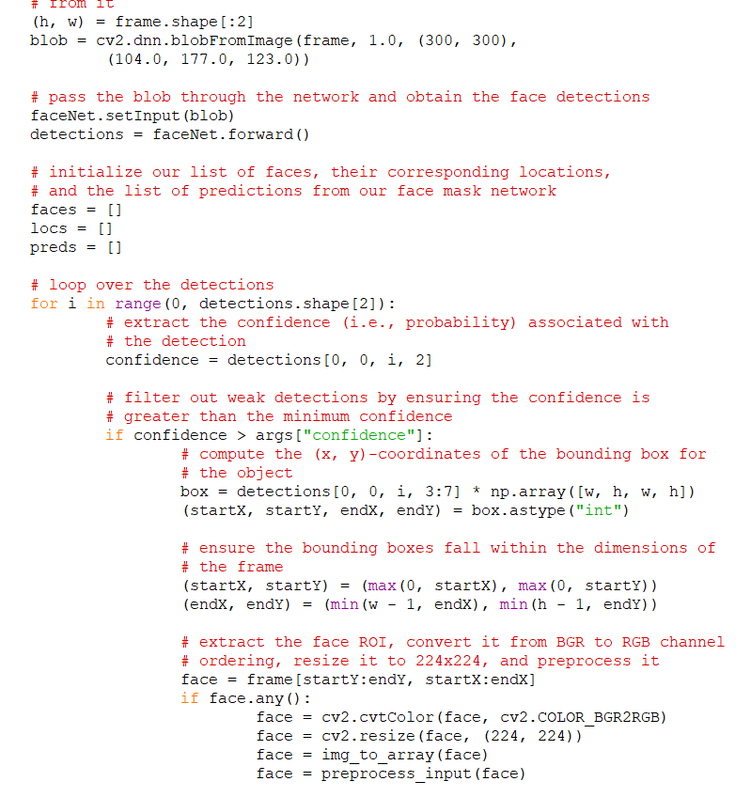

Slide 16
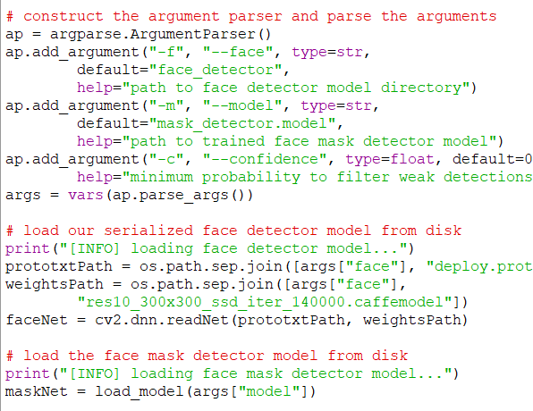

Slide 17
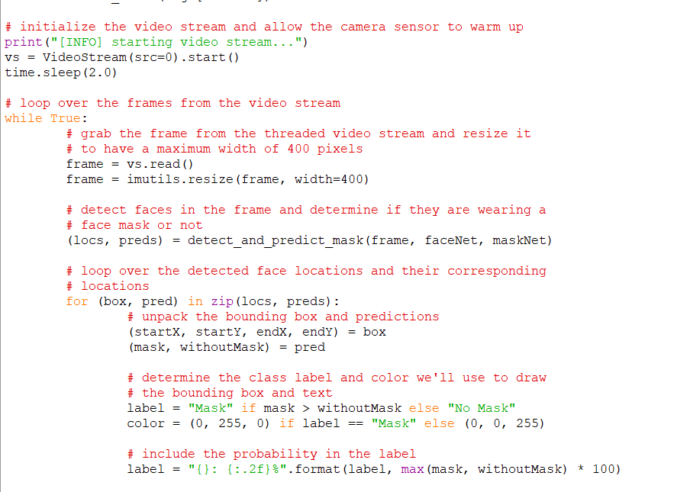

Slide 18
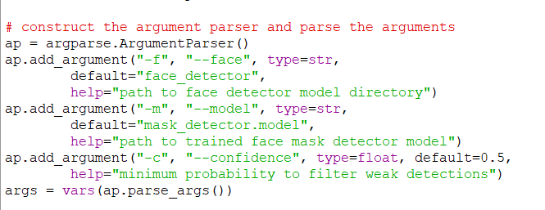

Slide 19
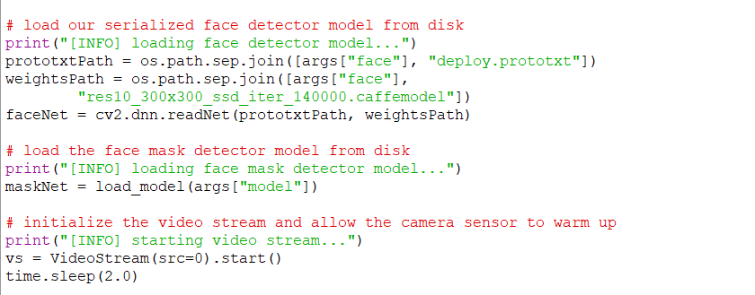

Slide 20
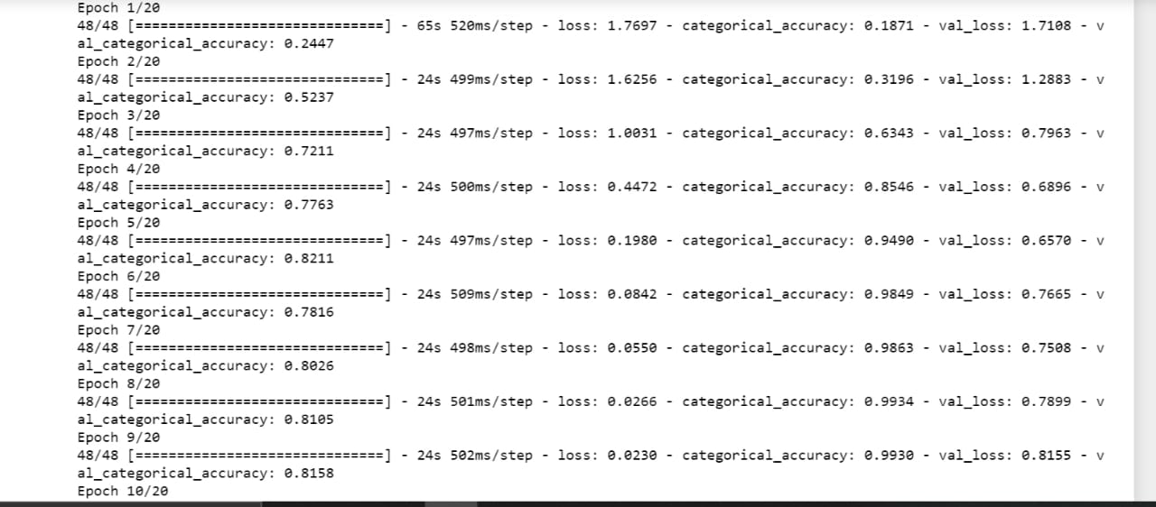
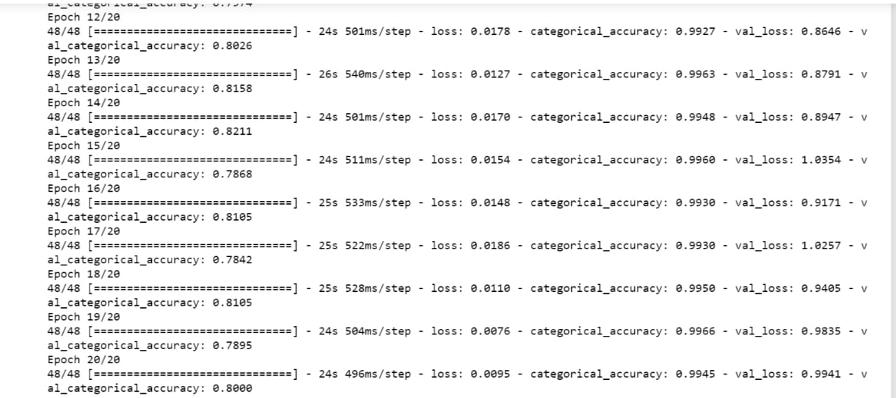

Slide 21
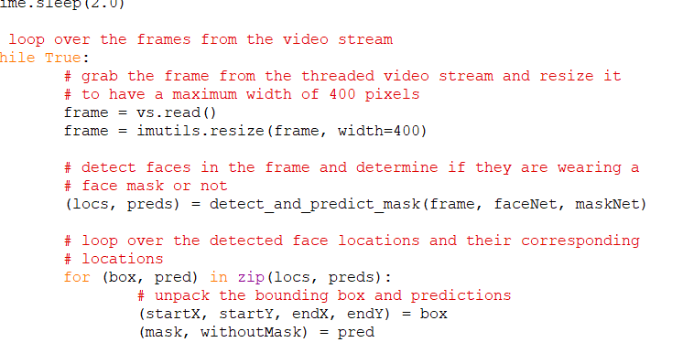

Slide 22
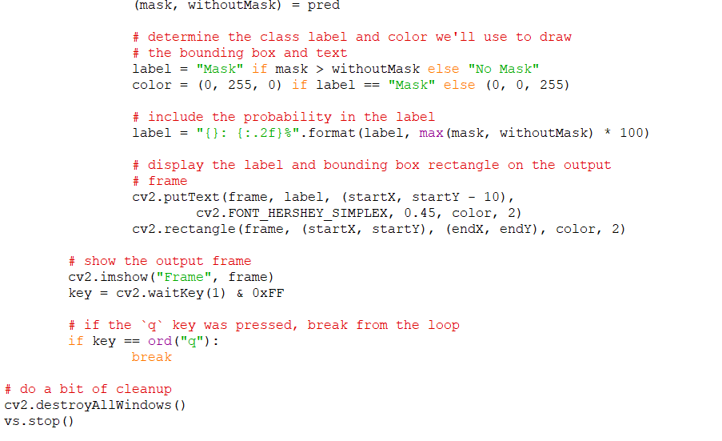
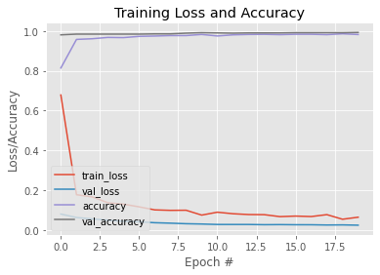

Slide 23
Conclusion
In this paper, we briefly explained the motivation of the work at first. Then, we illustrated the learning and performance task of the model. Using basic ML tools and simplified techniques the method has achieved reasonably high accuracy. It can be used for a variety of applications. Wearing a mask may be obligatory in the near future, considering the Covid-19 crisis. Many public service providers will ask the customers to wear masks correctly to avail of their services. The deployed model will contribute immensely to the public health care system. In future it can be extended to detect if a person is wearing the mask properly or not. The model can be further improved to detect if the mask is virus prone or not i.e. the type of the mask is surgical, N95 or not.

Slide 24
Thank You

